Slide 1


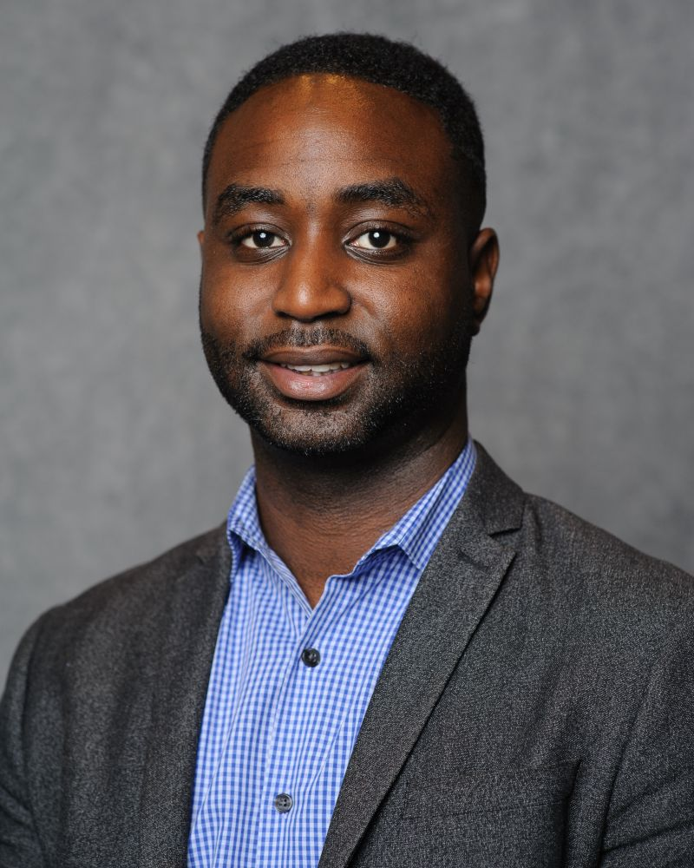
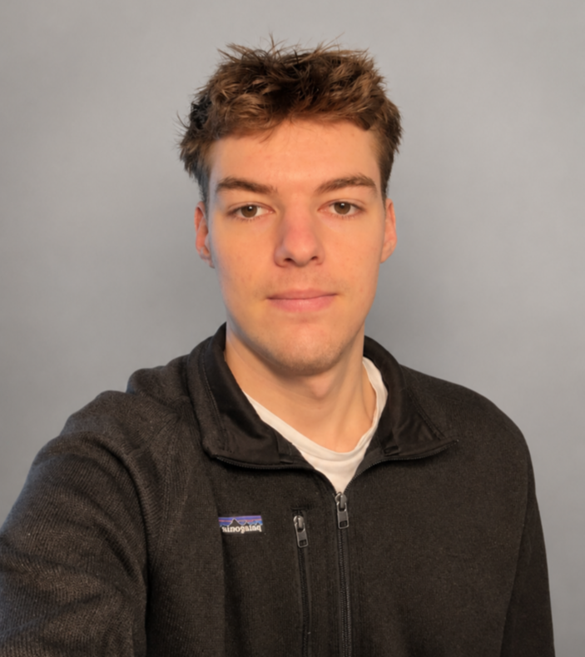
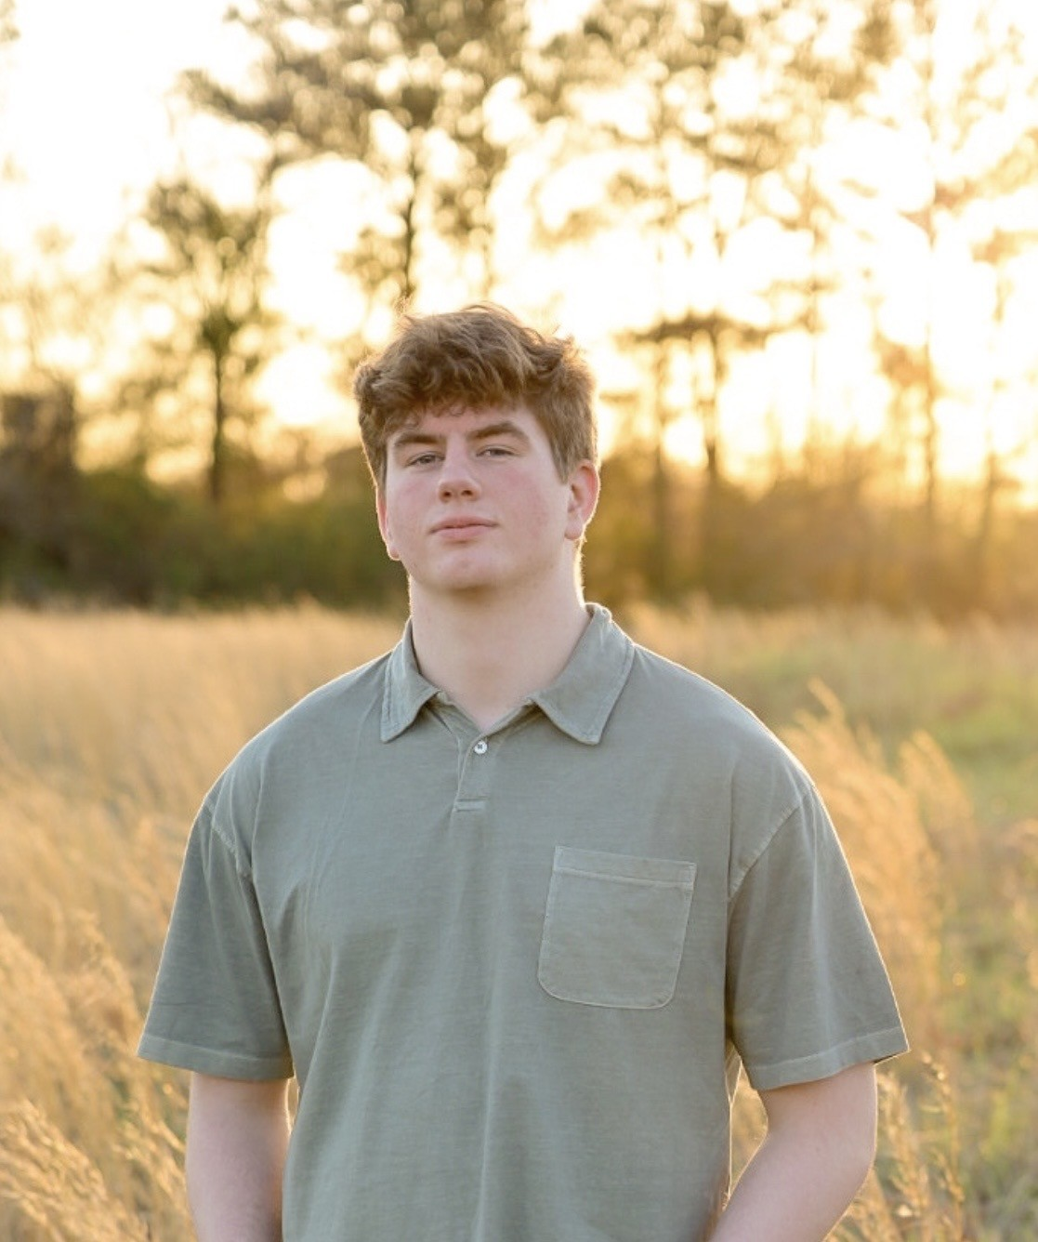

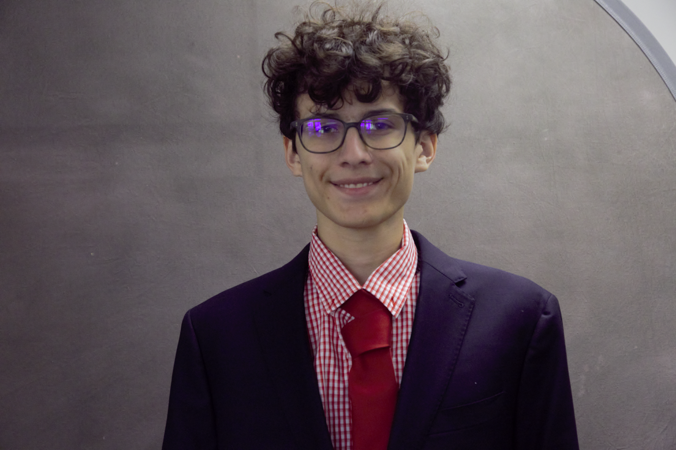
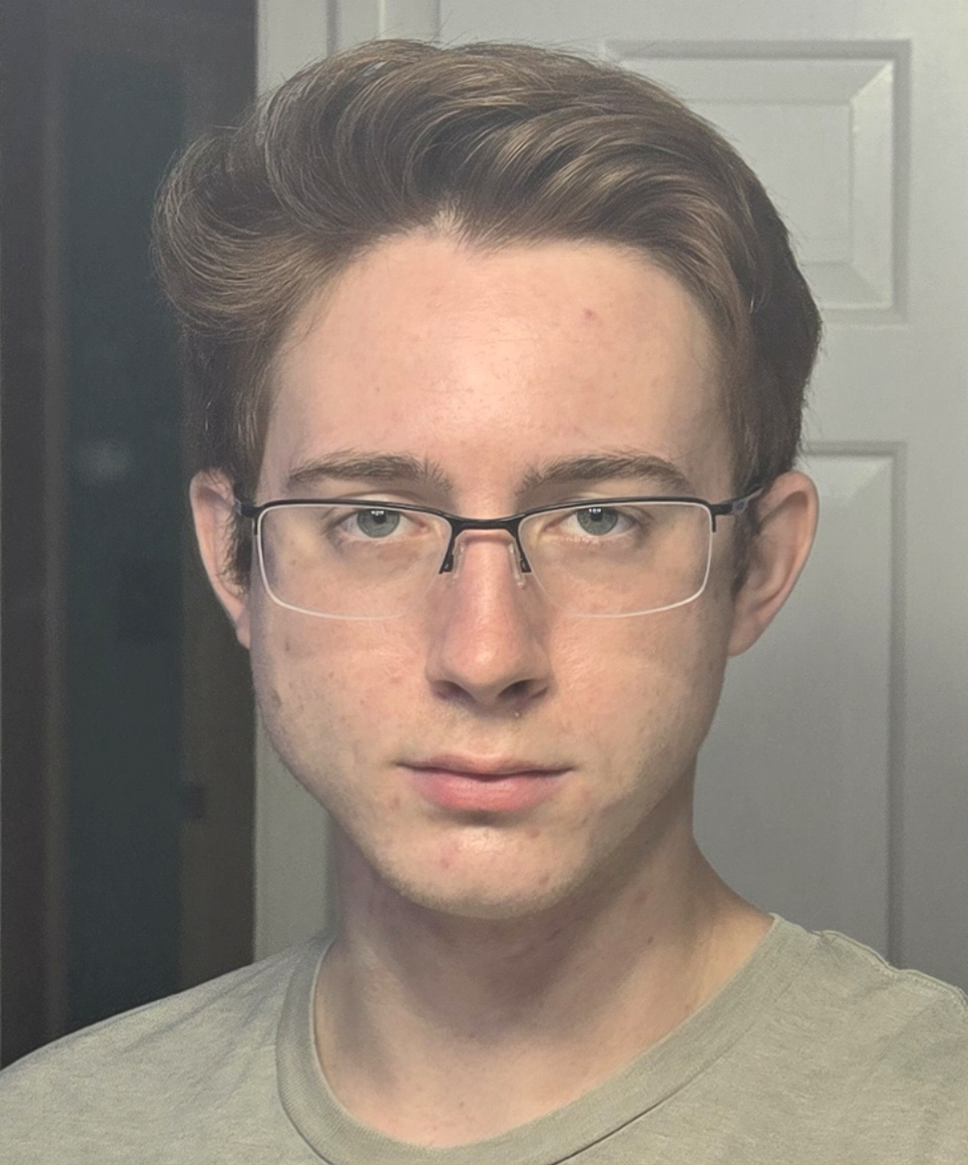
1
CS 495: Iteration 2 Presentation
Multi-User Physiological Computing
Dr. Chris Crawford
Trenton Ottman
Ansel Stinnett
Zara Ahmed
Jackson Wallace
James Adler
Speaker:
Everyone
Notes:
5 seconds

Slide 2
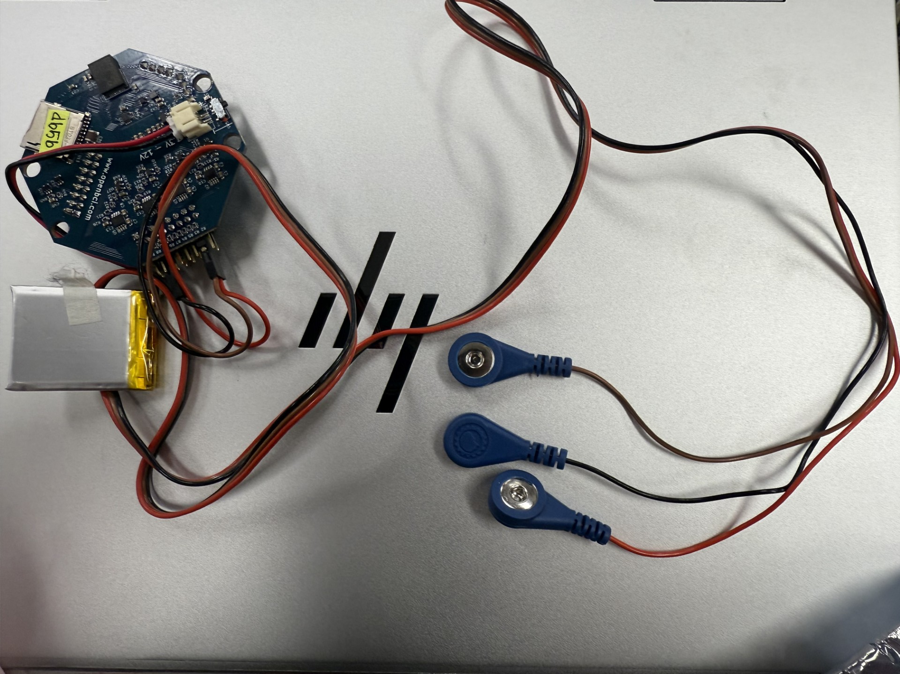
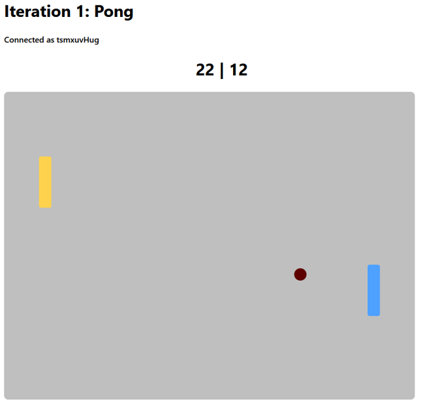
2
3
Project Review
Goal: Create a multiplayer game utilizing EMG sensors.
Iteration 1: Proof of concept multiplayer pong implementation.
Iteration 2: MVP 8 player multiplayer game with EMG input.
Speaker:
James Adler
Notes:
Zara

Slide 3

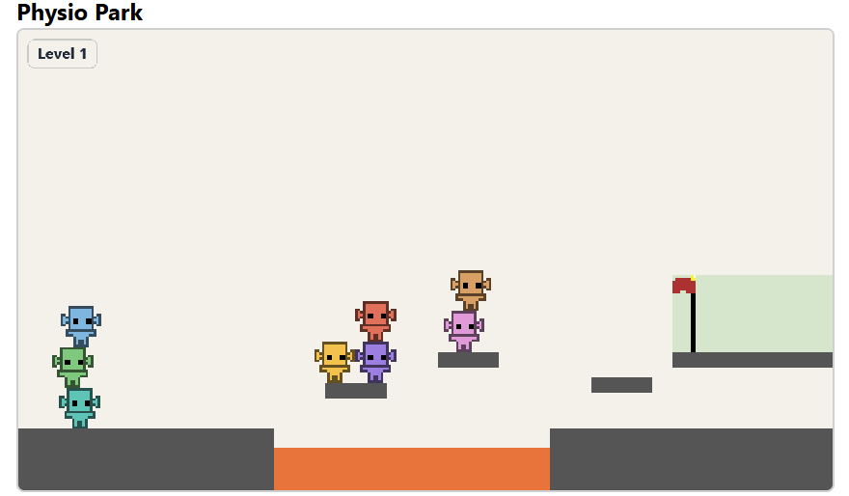
3
4
Planning & Actualizing
Iteration goal: make an 8-12 player multiplayer game with sensor used for inputs
Pick final game idea
Make project user friendly
Created lobby system
Updated Sensor UI
Created Physio Park game
Speaker:
Jackson Wallace
Notes:
Trenton

Slide 4

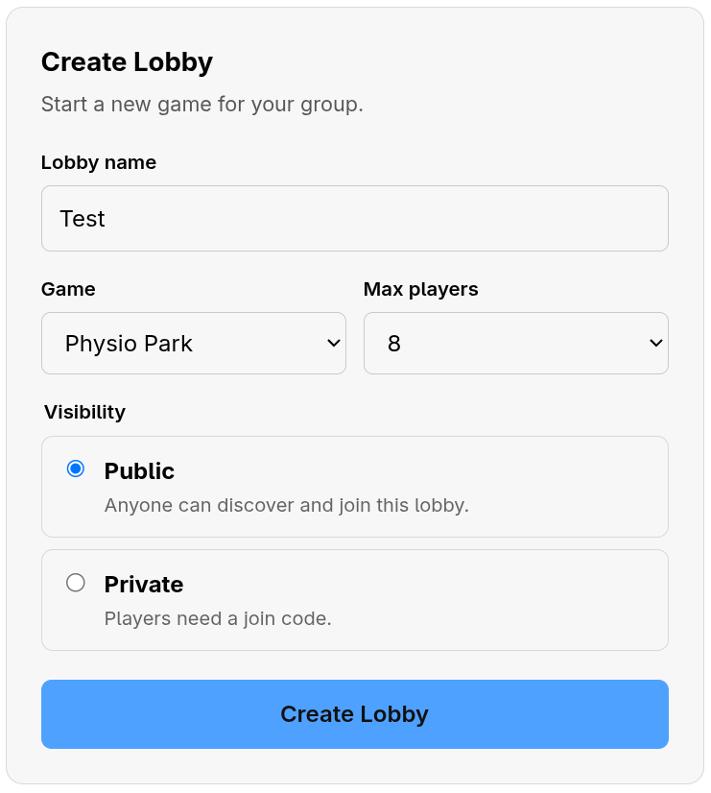
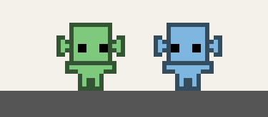
4
Major Accomplishments
Created a working lobby system, including public and private rooms
Established generalized game physics
Translated sensor inputs into player movement (jumping)
Designed hand-drawn sprites and animations
Built 2 playable levels
Speaker:
Trenton Ottman
Notes:
For sprint 1:
Decided:
- Will be a web app
- Will support 8-12 concurrent players in real time
Undecided:
- What networking tool will we use?
- What game engine will we develop on?
- How much of the previous project will we keep?
- Do we want to try and fix their machine learning gesture algorithm? (caused performance issues, target device is $200 chromebooks)

Slide 5
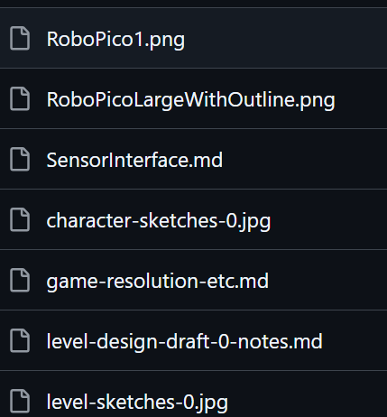
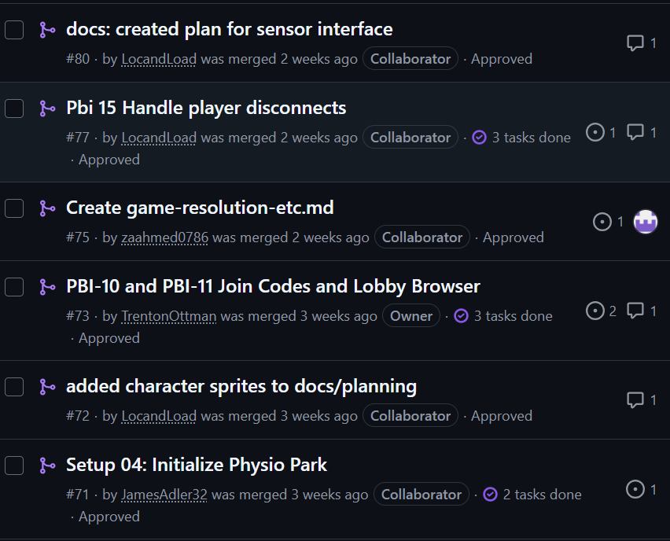
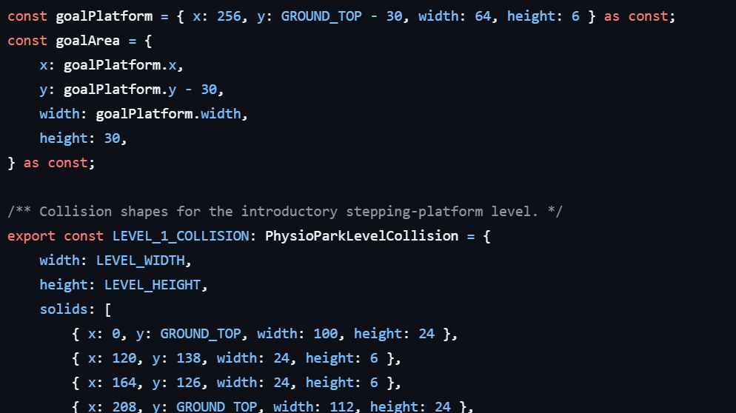
5
3
Engineering & Quality
Limitations
  No robust level editing system yet
  Tuning the sensor input
Security: Rate limiting
  Cyber gave us approval!
Quality: Mandatory review system for PRs & Manual game testing
Planning Docs & Decisions
  Game Specs/Design
  Level Design
Important PRs:
  #71: Initializing Physio Park (Level 1)
  #73: Join Codes & Lobby
  #107: Added Sensor Input
Speaker:
Zara Ahmed
Notes:
Zara

Slide 6
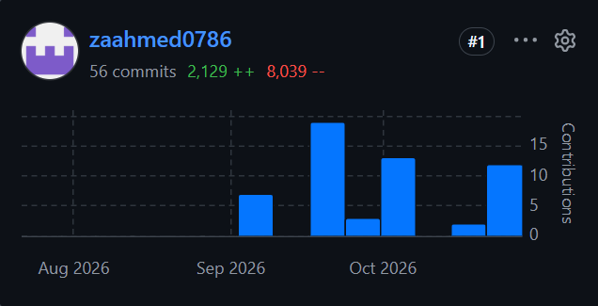
6
4
Team Contributions - Zara
Documentation for Level 1 & general game design
Added a player naming system
Made tile sets & level editor setup
Speaker:
Zara Ahmed

Slide 7
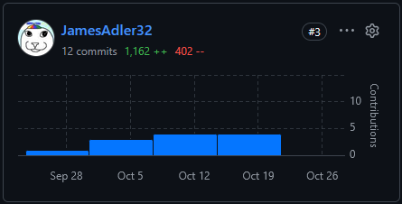
7
4
Team Contributions - James
Partially generalized physics implementation
Physio Park setup, resolution, and scaling
Asset loading and some animations
Speaker:
James Adler

Slide 8
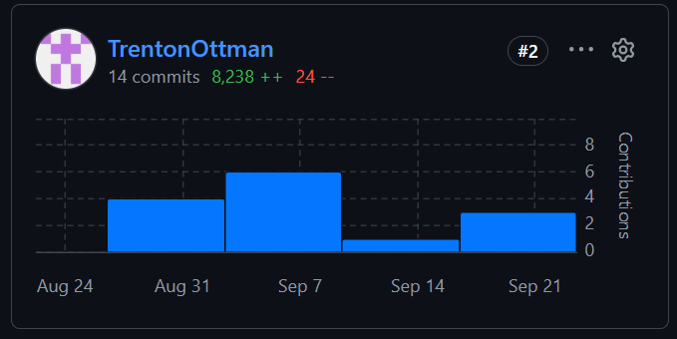
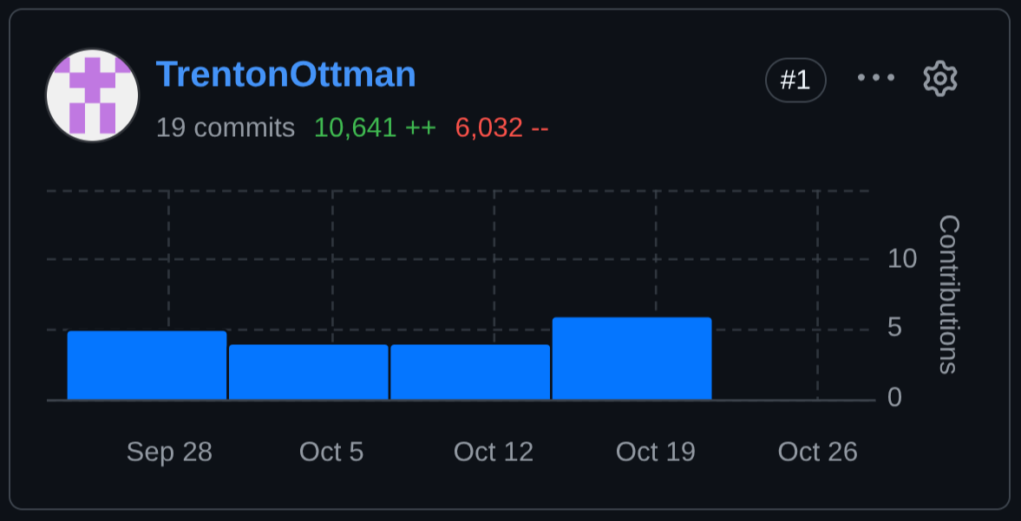
8
4
Team Contributions - Trenton
Public and private lobbies, lobby waiting rooms, host controls, and starting a game
Level completions and transitions
Level 2 design, sprites, and implementation
Speaker:
Trenton Ottman

Slide 9
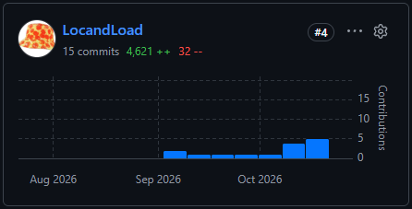
9
4
Team Contributions - Jackson
Created sprites for Physio-Park
Worked on using the sensor as an input for the user
Worked on allowing users to rejoin on disconnect
Speaker:
Jackson Wallace

Slide 10
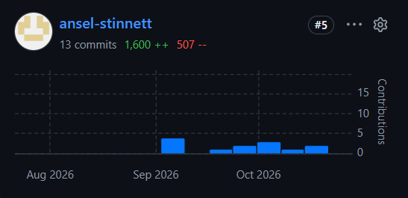
10
4
Team Contributions – Ansel
Reviewed Game engine
Built platformer physics and stacking
Connected the physics to the multiplayer server for controlling movement
Groundwork for client-side prediction
Speaker:
Ansel Stinnett

Slide 11

11
Lessons Learned & Upcoming
Lobby and room system from Iteration 1 carried straight into Physio Park which allowed for focus on gameplay
  Phaser/Typescript technical learning
PBIs help build in parallel, but coordinating early can help merge order in the future.
Running the physics on the server keeps player in sync & EMG input needed tuning
Iteration 3:
  Client-side prediction (for smoother movement)
  Add more levels
  Improve sensor reliability
  Play-test with more (8) players.
Speaker:
Ansel Stinnett
Notes:
Identify important product, technical, or process learning and explain how it affects Iteration 2.
Lobby and room system from Iteration 1 carried straight into Physio Park which allowed for focus on gameplay
Phaser/Typescript technical learning
PBIs help build in parallel, but coordinating early can help merge order in the future.
Running the physics on the server keeps player in sync & EMG input needed tuning
Iteration 3:
Client-side prediction (for smoother movement)
Add more levels
Improve sensor reliability
Play-test with more (8) players.

Slide 12
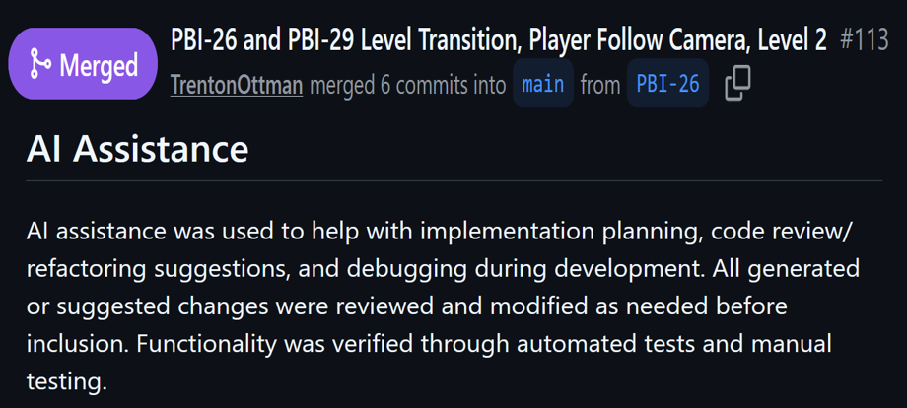
12
3
AI Usage
Documentation
Prototyping and code assistance
Debugging
Speaker:
James Adler
Notes:
Verified by checking over all output manually and cross references documentation when applicable. Furthermore, everything had to be reviewed when made into a PR.

Slide 13

1
Questions?
Notes:
10 seconds

